Slide 1


C# Events

Slide 2
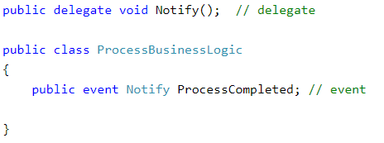
Declaring an Event
Before you can declare your event, you must create a delegate
You would then go into the class that you want to place the event inside of and create the event based on the delegate that you created initially.

Slide 3
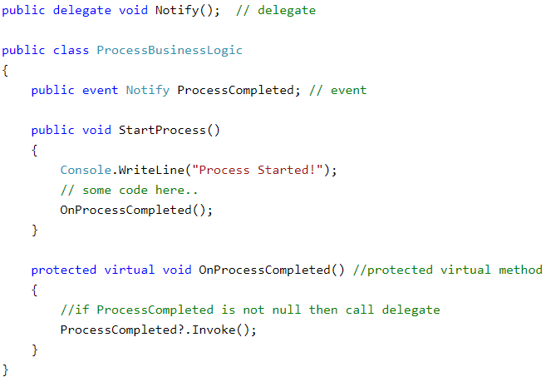
Raising an Event
Once the delegate has been made and the event has been made from that delegate, you have to call, or raise, that event.
Here in our example, you can see that the event is being called by the OnProcessCompleted() function.
When the OnProcessCompleted() function runs and the Invoke() function at the bottom, this will call all event handler methods with the ProcessCompleted event.

Slide 4
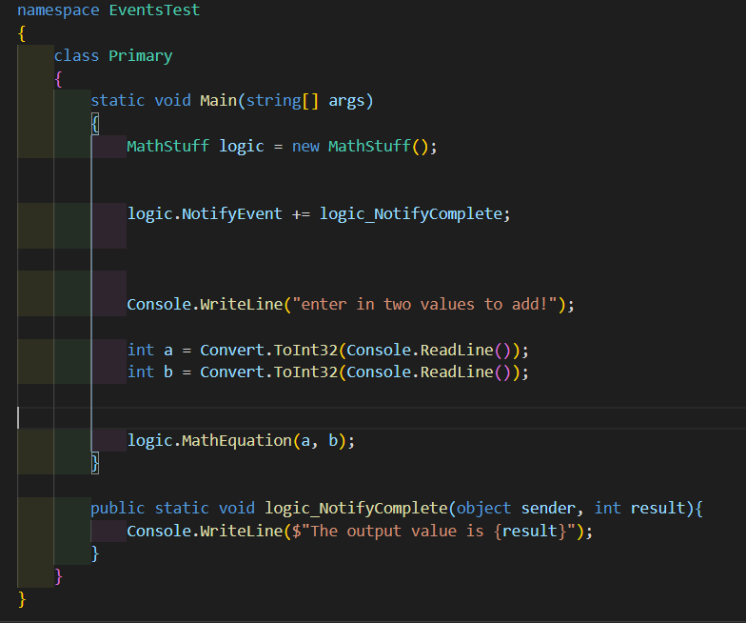
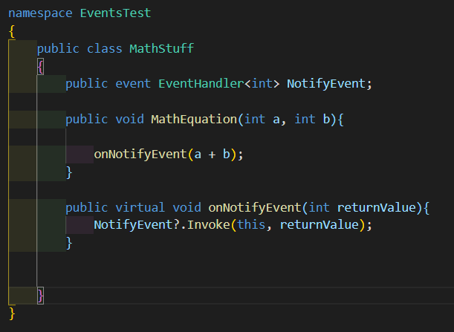
How does an Event Work?
A class which defines the event is considered the “publisher” while any classes that retrieve the event are considered “subscribers”
Subscriber Class
Publisher Class

Slide 5

Passing in Event Data
To declare an event which receives and passes data, you will use the EventHandler<TEventArgs> delegate.
Event data is handled by the base EventArgs class.
The base EventArgs class can handle a single data type.

Slide 6
Passing Multiple Datatypes at Once
In order to pass multiple data types to an event, you can create a custom class extending EventArgs to include the necessary backing fields and properties.
.NET also provides some custom EventArgs classes to handle data, like SerialDataReceivedEventArgs (used for data handling events)
Custom EventArgs classes should be named with EventArgs following the class purpose.
Example: FileUploadEventArgs

Slide 7
Multiple Datatypes Example Case: User File Upload
Let’s say a user is uploading a file to your program. You might want to keep track of multiple properties to relate pertinent information to the user and your database.
File upload date (DateTime), file type(String), upload success(bool), etc
Some of this information might be presented to the user through a UI layer class, and some might be processed by a database connection.
A custom EventArgs child class will make this process much easier and more scalable!

